Slide 1
北京大学微处理器研发中心
硕士工作汇报
BOOM Core
姓名 | 阳庆红
学号 | 1501214366
年级 | 2015级

Slide 2
主要内容
Introduction & Overview
Instruction Fetch
Unified Physical Register File
The Decode Stage
The Rename Stage
ROB & The Dispatch Stage
The Issue Unit
The Register File and Bypass
The Execute Pipeline
The Load/Store Unit
后期工作安排

Slide 3
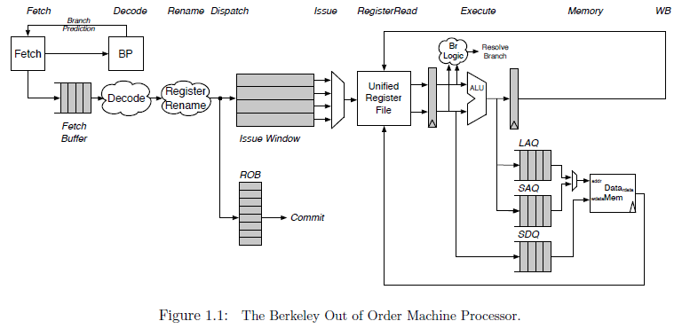
Introduction & Overview
A unified physical register file design
Superscalar、Out of Order、Six stages
Fetch, Decode/Rename/Dispatch, Issue/RegisterRead, Execute, Memory, and Writeback
Notes:
1. Commit occurs asynchronously
2.

Slide 4
主要内容
Introduction & Overview
Instruction Fetch
Unified Physical Register File
The Decode Stage
The Rename Stage
ROB & The Dispatch Stage
The Issue Unit
The Register File and Bypass
The Execute Pipeline
The Load/Store Unit
后期工作安排

Slide 5
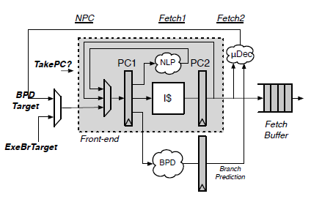
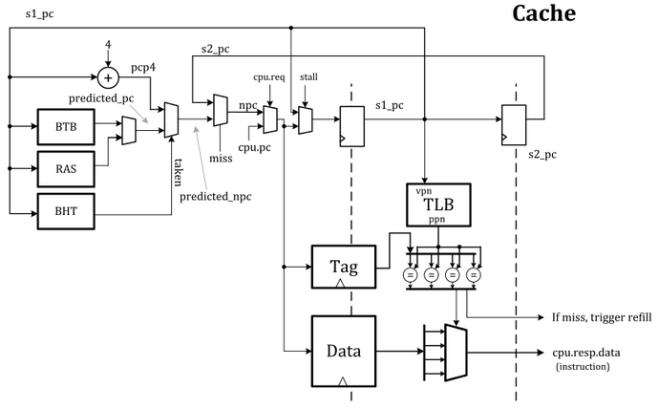
Instruction Fetch
Rocket Core’ Front-end
BOOM Fetch Unit
BOOM instantiates the Rocket core's Front-end
If a misprediction is detected, or BOOM's own predictor wants to redirect the pipeline in a difference direction, a request is sent to the Front-End and it begins fetching along a new instruction path

Slide 6
Instruction Fetch
Rocket Core’ Front-end
BOOM Fetch Unit
Since superscalar fetch is supported, the Front-end returns a fetch packet of instructions
The I-Cache is a virtually indexed, physically tagged set-associative cache

Slide 7
主要内容
Introduction & Overview
Instruction Fetch
Unified Physical Register File
The Decode Stage
The Rename Stage
ROB & The Dispatch Stage
The Issue Unit
The Register File and Bypass
The Execute Pipeline
The Load/Store Unit
后期工作安排

Slide 8
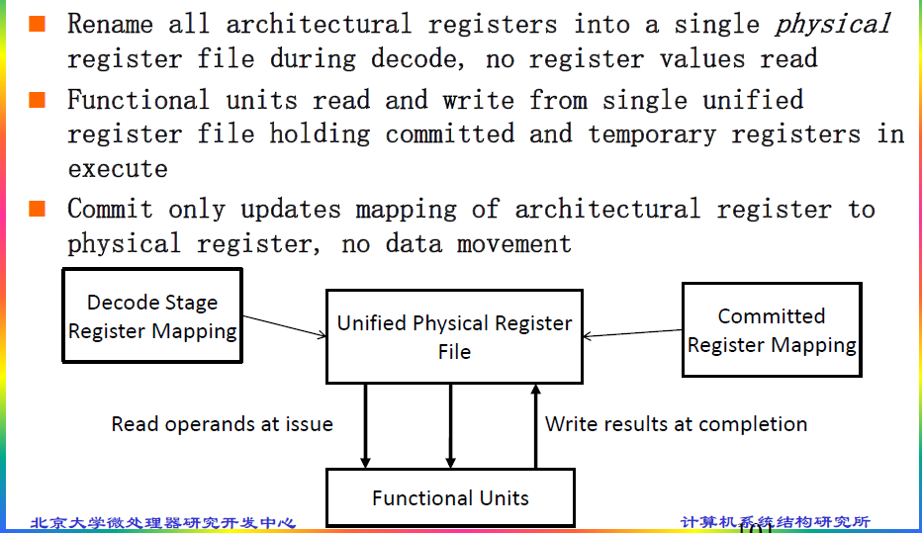
Unified Physical Register File

Slide 9
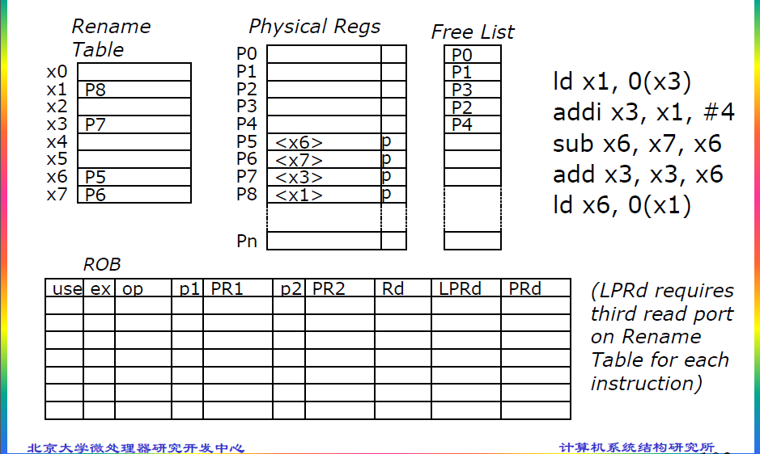
Unified Physical Register File

Slide 10
主要内容
Introduction & Overview
Instruction Fetch
Unified Physical Register File
The Decode Stage
The Rename Stage
ROB & The Dispatch Stage
The Issue Unit
The Register File and Bypass
The Execute Pipeline
The Load/Store Unit
后期工作安排

Slide 11
The Decode Stage
The decode stage takes instructions from the fetch buffer, decodes them, and allocates the necessary resources as required by each instruction. The decode stage will stall as needed if not all resources are available.

Slide 12
主要内容
Introduction & Overview
Instruction Fetch
Unified Physical Register File
The Decode Stage
The Rename Stage
ROB & The Dispatch Stage
The Issue Unit
The Register File and Bypass
The Execute Pipeline
The Load/Store Unit
后期工作安排

Slide 13
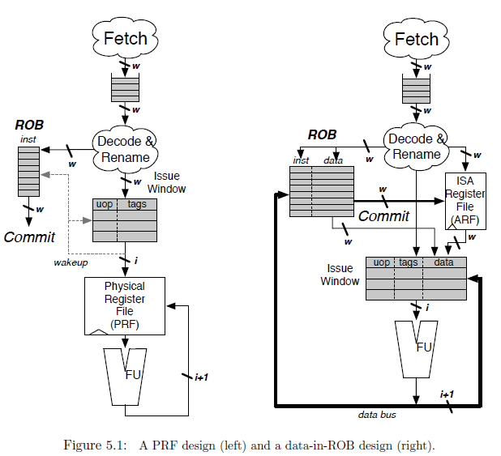
The Rename Stage
WAW & WAR
Explicit & Implicit
Committed & Speculative
Branch
Exception
Notes:
register renaming eliminates write-after-write (WAW) and write-after-read (WAR) hazards, which are artifacts introduced by a) only having a limited number of ISA registers to use as specifiers and b) loops, which by their very nature will use the same register specifiers on every loop iteration.
As instructions are renamed, their register specifiers are explicitly updated to point to physical registers located in the physical register file
A physical register file, containing many more registers than the ISA dictates, holds both the committed architectural register state and speculative register state.
This is in contrast to an "implicit renaming" or "data-in-ROB" out-of-order core design. The Architectural Register File only holds the committed register state, while the ROB holds the speculative write-back data
Each branch gets its own copy of the rename map table. On a branch mispredict, the map table can be reset from the mispredic branch's copy of the map table.
Exception： 两种策略（一步到位、回滚）

Slide 14
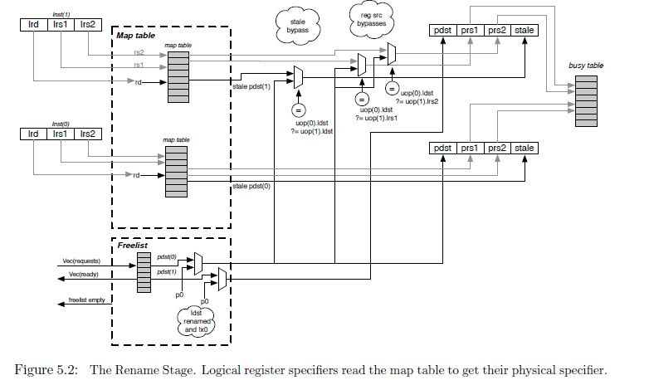
The Rename Stage
Notes:
1. The Busy Table tracks the readiness status of each physical register. If all physical operands are ready, the instruction will be ready to be issued.
2. The Free List is implemented as a bit-vector. A priority decoder can then be used to find the first free register. BOOM uses a cascading priority decoder to allocate multiple registers per cycle
3. Free List support for Branch：the Free List also sets aside a new "Allocation List", initialized to zero. As new physical registers are allocated, the Allocation List for each branch is updated to track all of the physical registers that have been allocated after the branch. If a misspeculation occurs, its Allocation List is added back to the Free List by OR'ing the branch's Allocation List with the Free List

Slide 15
主要内容
Introduction & Overview
Instruction Fetch
Unified Physical Register File
The Decode Stage
The Rename Stage
ROB & The Dispatch Stage
The Issue Unit
The Register File and Bypass
The Execute Pipeline
The Load/Store Unit
后期工作安排

Slide 16
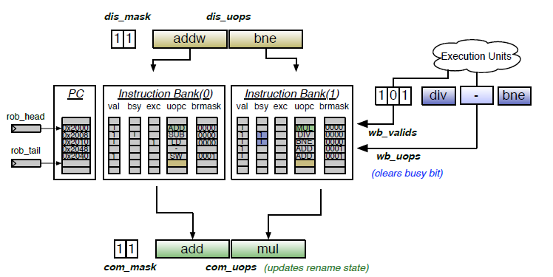
ROB & The Dispatch Stage
ROB Organization
circular buffer、w banks
valid/busy/exception/branch mask/uopc/lrd/stale pdst
floating-point status updates/other miscellaneous data
Figure 6.1: The Reorder Buffer for a two-wide BOOM with three-issue
Notes:
1. 跟踪流水线上所有指令、按序执行的假象
2. Dispatch：ROB & Issue Window、marked busy，如果指令Completed就会被标记为not busy
3. 若位于ROB head的指令发生Exception，ROB可以选择回滚的方式回退机器状态（table mapping 和 free list），整个流水线会被flush
4. W 是同时Dispatch或提交的指令数目
5. 每次被dispatch的指令必须是地址连续的，并且是对齐的，这样子多个bank能共享PC的高位域，PC的低位域用来索引Bank。所以，branch指令可能带来Bubble
6. other miscellaneous（五花八门） data (e.g., helpful for statistic（统计的） tracking)
7. 当store指令被提交时，该指令被发送到memory，对于多个stores同时被提交，LSU会被告知有多少个stores被提交，LSU将会依次提交stores到memory。

Slide 17
主要内容
Introduction & Overview
Instruction Fetch
Unified Physical Register File
The Decode Stage
The Rename Stage
ROB & The Dispatch Stage
The Issue Unit
The Register File and Bypass
The Execute Pipeline
The Load/Store Unit
后期工作安排

Slide 18
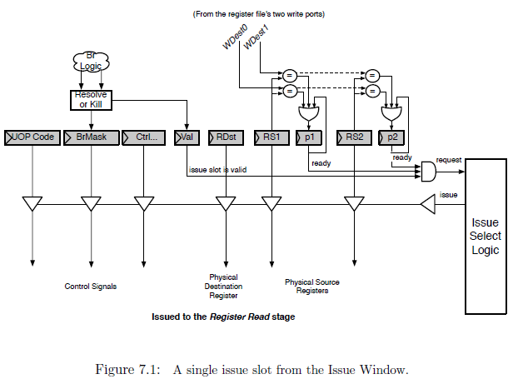
The Issue Unit
Issue window
Issue slot
Notes:
Issue window中保存还没有执行的微指令，微指令的操作数准备好，并且没有因为转移预测错误被取消时，会把request信号置为高，选择逻辑会在request信号有效的指令中选择进行发射
所有类型的指令共用一个发射窗口 发射逻辑有多个端口，每个端口处理一类微指令，选择逻辑实际上是一系列固定的优先级
功能单元无法使用时发射逻辑会取消掉request信号，等待wake-up重新开始发射指令
wake-up分为两种，fast wake-up和slow wake-up

Slide 19
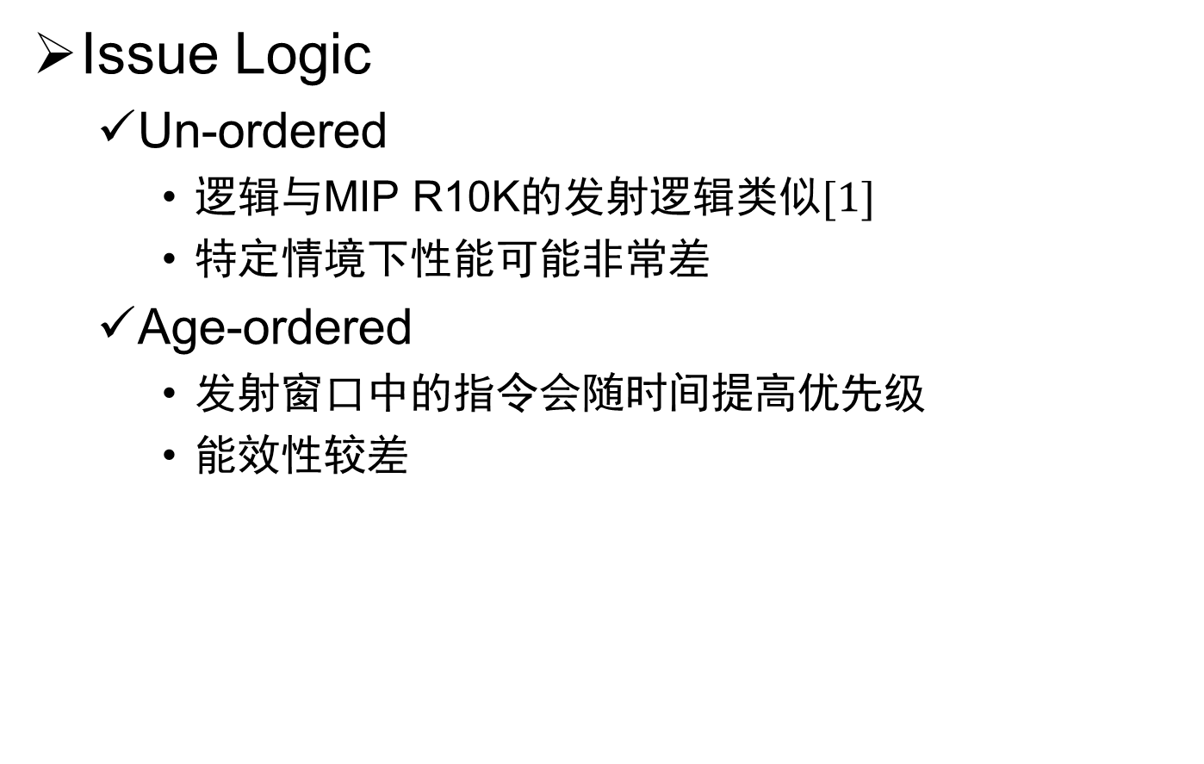
The Issue Unit
Issue Logic
Un-ordered
逻辑与MIP R10K的发射逻辑类似$[1]$
特定情境下性能可能非常差
Age-ordered
发射窗口中的指令会随时间提高优先级
能效性较差
[1] K. Yeager. The MIPS R10000 Superscalar Microprocessor. IEEE Micro, 16(2):28-41, 1996.
Notes:
Unordered：无法预测的分支指令会放在低优先级的位置上，直到ROB被填满，发射窗口开始收缩前，这个分支指令不会被发射

Slide 20
主要内容
Introduction & Overview
Instruction Fetch
Unified Physical Register File
The Decode Stage
The Rename Stage
ROB & The Dispatch Stage
The Issue Unit
The Register File and Bypass
The Execute Pipeline
The Load/Store Unit
后期工作安排

Slide 21
The Register File and Bypass
BOOM使用统一的物理寄存器堆
同时包含整数寄存器和浮点寄存器
用映射表实现寄存器重命名
读写口数量
能满足所有发射的指令
读写口与发射逻辑的端口对应关系固定
Bypass在Register Read阶段最后发生
REG
ALU
Issue
Logic
FPU
Notes:
BOOM使用了Berkeley hardfloat floating point units，硬件浮点单元内部使用65位操作数，因此所有的寄存器都是65位
假设

Slide 22
主要内容
Introduction & Overview
Instruction Fetch
Unified Physical Register File
The Decode Stage
The Rename Stage
ROB & The Dispatch Stage
The Issue Unit
The Register File and Bypass
The Execute Pipeline
The Load/Store Unit
后期工作安排

Slide 23
The Execute Pipeline
Execution Pipeline
Execution Unit
EU包含的Function Unit

Slide 24
主要内容
Introduction & Overview
Instruction Fetch
Unified Physical Register File
The Decode Stage
The Rename Stage
ROB & The Dispatch Stage
The Issue Unit
The Register File and Bypass
The Execute Pipeline
The Load/Store Unit
后期工作安排

Slide 25
The Load/Store Unit
三个队列
LAQ位域
LSU Behaviour
TLB miss？
Bypass？
Memory Modle
Memory System & DCache Shim

Slide 26
主要内容
Introduction & Overview
Instruction Fetch
Unified Physical Register File
The Decode Stage
The Rename Stage
ROB & The Dispatch Stage
The Issue Unit
The Register File and Bypass
The Execute Pipeline
The Load/Store Unit
后期工作安排

Slide 27
后期工作安排
 | 任务 | 人数 | 文档章节 | 代码文件（.scala) | 代码行数
按序部分 | Instruction Fetch | 1 | 第二章（2页） | fetch | 253+
 | Branch Prediction | 2 | 第三章（14页） | brpredictor/bpd_pipeline/2bc-table/simplegshare/gshare/gskew/tage/Tage-csr/tage-table/tage-tagmemory/tage-ubits | 3461
 | Decode & Rename | 1 | 第四/五章（5页） | decode/fudecode/microop/rename | 1889
 | ROB & Dispatch | 1 | 第六章（4页） | rob | 1085
乱序部分 | Issue Unit | 1 | 第七章（3页） | issue/issue_slot/issue_ageordered/issue_unordered | 668
 | Register File & Bypass Network | 1 | 第八章（2页） | regfile/registerread | 304
 | Execute Pipeline | 2 | 第九章（8页） | execute/execution_units/functional_unit/imul | 1679
 | LSU & Dcache Shim | 2 | 第十章（5页） | lsu/dcacheshim | 1757

Slide 28
后期工作安排（探讨）
阅读文档和熟悉代码，了解Boom的整体架构，重点掌握各位负责的子模块的功能和对外连接情况。（1周）
阅读文档和代码，探索各子模块的设计方案（4周）
书写详细设计文档（2周）

Slide 29
谢谢！

